Slide 1

IS-201 - Database Chapter 3 – Introduction to SQL
Part(3) of (4)
DAW MAY THU KYAW
LECTURER
Faculty of Information Science

Slide 2
Outlines
Null Values
Aggregate Functions

Slide 3
Null Values
It is possible for tuples to have a null value, denoted by null, for some of their
attributes
The value null signifies an unknown value or that a value does not exist.
The predicate is null can be used to check for null values.
Example: Find all instructors whose salary is null.
select name from instructor where salary is null
The predicate is not null succeeds if the value on which it is applied is not null.

Slide 4
Examples
Example: Find the names of all instructors with salary value null
select name from instructor where salary is null
Example: Find the names of all instructors with salary value greater than100000 is unknown
select name from instructor where salary > 100000 is unknown

Slide 5
Aggregate Functions
These functions operate on the multiset of values of a column of a relation, and
return a value
avg: average value min: minimum value max: maximum value sum: sum of values count: number of values

Slide 6
Aggregate Functions Examples
Find the average salary of instructors in the Computer Science department
select avg (salary) from instructor where dept_name= 'Comp. Sci.';
Find the total number of instructors who teach a course in the Spring 2018
semester
select count (distinct ID) from teaches where semester = 'Spring' and year = 2018;
Find the number of tuples in the course relation
select count (*) from course;

Slide 7
Aggregate Functions Examples
Find the minimum salary of instructors in the Computer Science department
select min (salary) from instructor where dept_name= 'Comp. Sci.’;

Slide 8
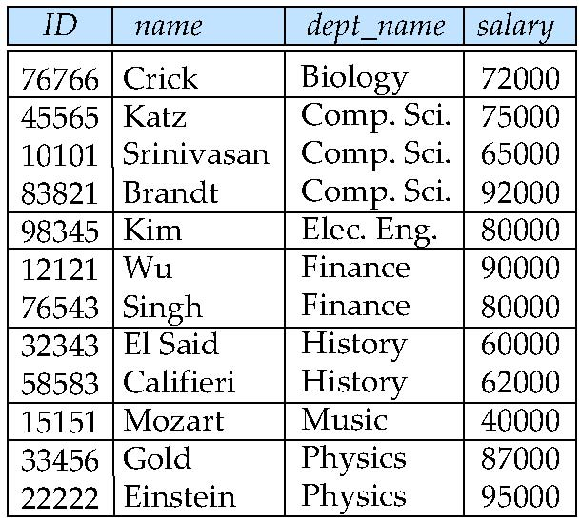
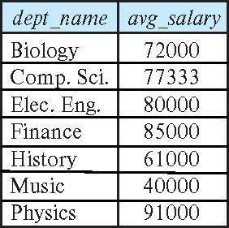
Aggregate Functions – Group By
Find the average salary of instructors in each department
select dept_name, avg (salary) as avg_salary from instructor group by dept_name;

Slide 9
Next Lecture
Nested Subqueries
Modification of the Database

